Slide 1
Matthew 6:7-15 (ESV)
7 "And when you pray, do not heap up empty phrases as the Gentiles do, for they think that they will be heard for their many words. 8Do not be like them, for your Father knows what you need before you ask him. 9Pray then like this: "Our Father in heaven, hallowed be your name. 10Your kingdom come, your will be done, on earth as it is in heaven. 11Give us this day our daily bread, 12and forgive us our debts, as we also have forgiven our debtors. 13And lead us not into temptation, but deliver us from evil. 14For if you forgive others their trespasses, your heavenly Father will also forgive you, 15but if you do not forgive others their trespasses, neither will your Father forgive your trespasses.

Slide 2
Matthew 6:19-21, 25-26 (ESV)
19"Do not lay up for yourselves treasures on earth, where moth and rust destroy and where thieves break in and steal, 20but lay up for yourselves treasures in heaven, where neither moth nor rust destroys and where thieves do not break in and steal. 21For where your treasure is, there your heart will be also.
25"Therefore I tell you, do not be anxious about your life, what you will eat or what you will drink, nor about your body, what you will put on. Is not life more than food, and the body more than clothing? 26Look at the birds of the air: they neither sow nor reap nor gather into barns, and yet your heavenly Father feeds them. Are you not of more value than they?

Slide 3
Matthew 6:33 (ESV)
33But seek first the kingdom of God and his righteousness, and all these things will be added to you.

Slide 4
The King's Manifesto
Matthew 5 to 7

Slide 5
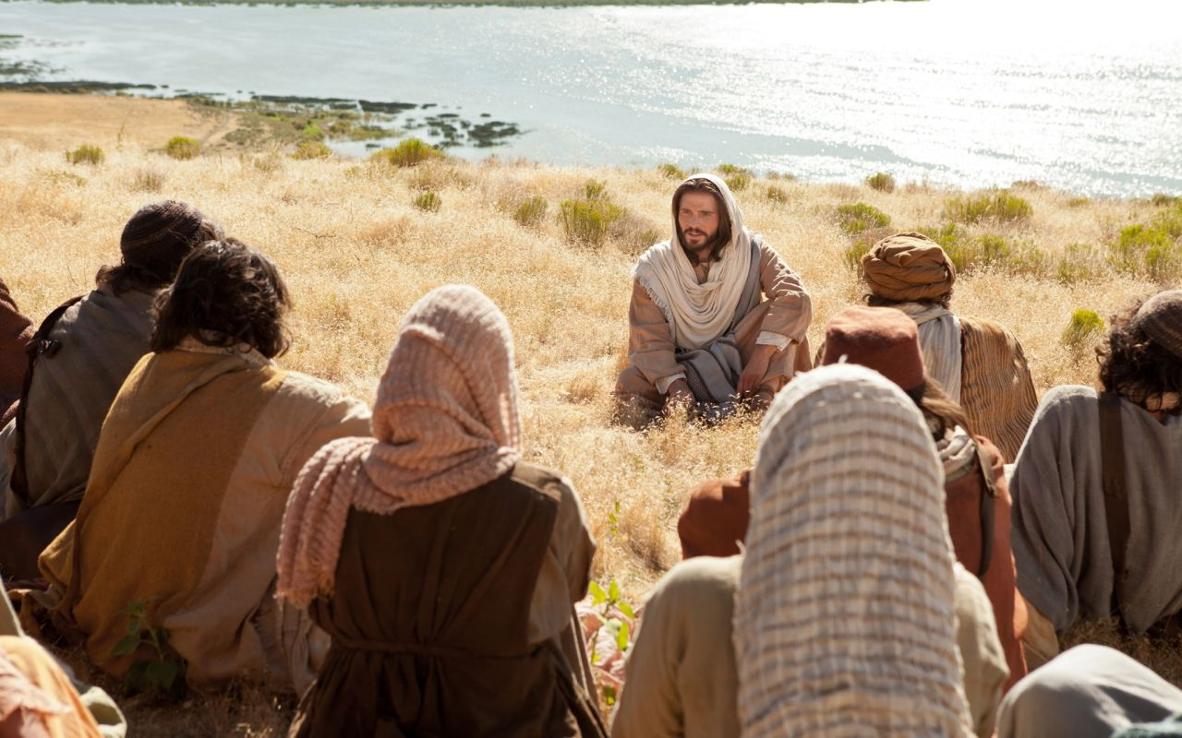
TODAY:
A New Devotion
Matthew 6

Slide 6
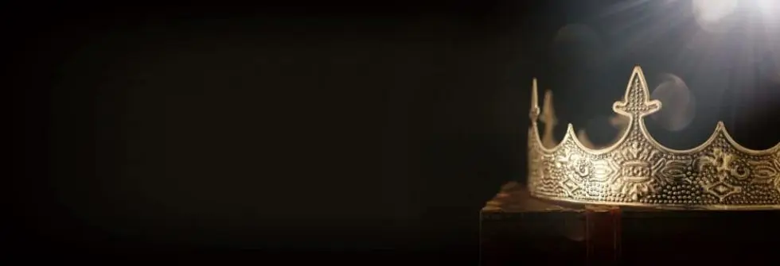
1. Loving God in our praying
(verses 5-15)
A Pattern prayer for Jesus’ disciples
6 petitions: first 3 - God’s desires
next 3 - our needs

Slide 7
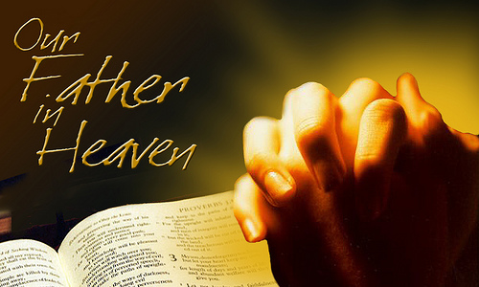
l. Devotion in prayer

Slide 8
Speaks of Loving relationship
Speaks of Lordship

Slide 9
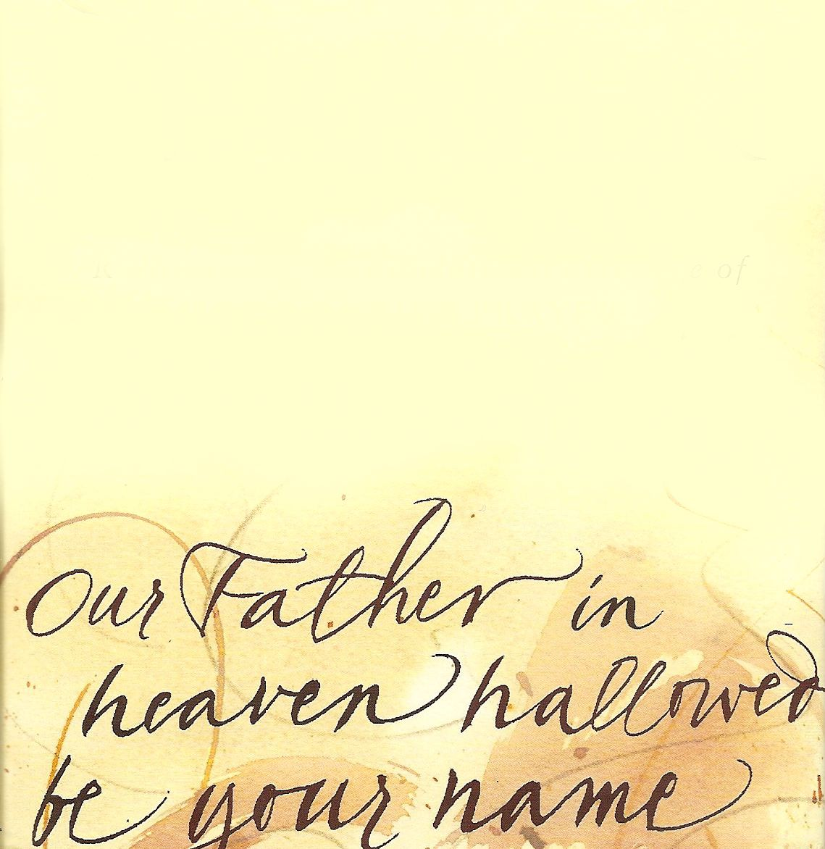
Concern for His Pre-eminence “Hallowed be Thy
Name”
Commitment to His purpose “Thy kingdom come”
Conformity to His will “Thy will be done…”

Slide 10
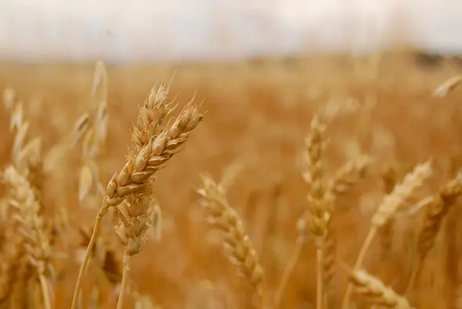
ll. Dependence in prayer

Slide 11
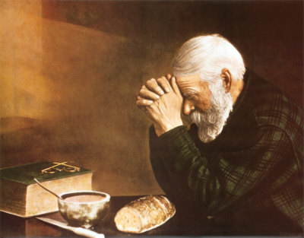
Our physical needs

Slide 12
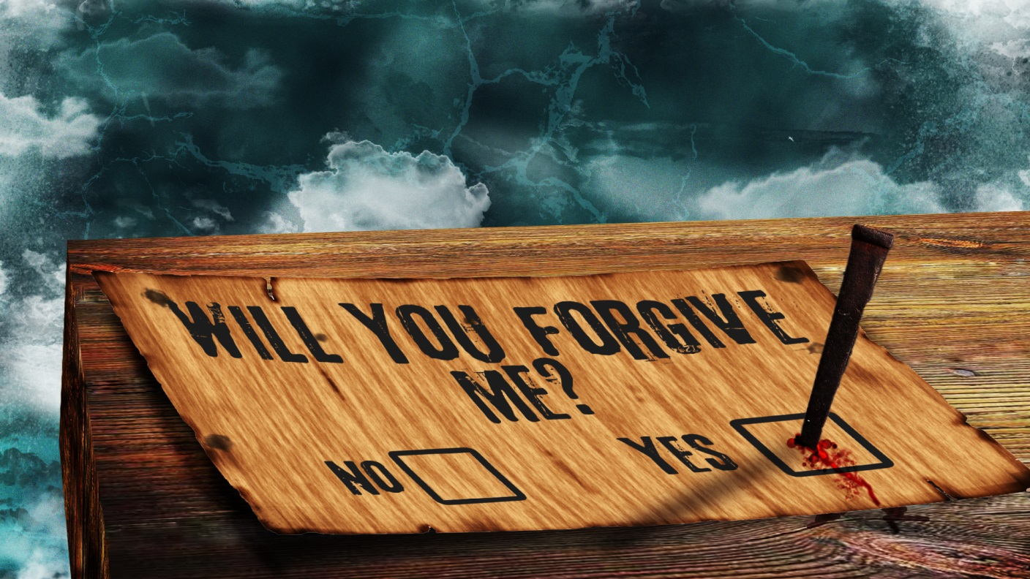
Our pardon

Slide 13
Our protection

Slide 14
2. Loving God with our possessions
(verses 19-34)
The key principle of the rest of chapter 6 is v.21
"where your treasure is, there your heart will be also"

Slide 15
Our commitment in loving Him
v. 19 "Do not lay up for
yourselves treasures
on earth"

Slide 16
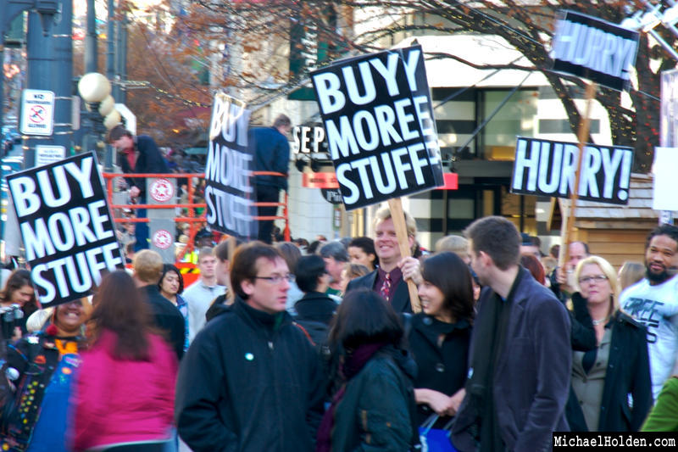
Either we are servants of God
or servants of materialism

Slide 17
Our consideration in loving Him

Slide 18
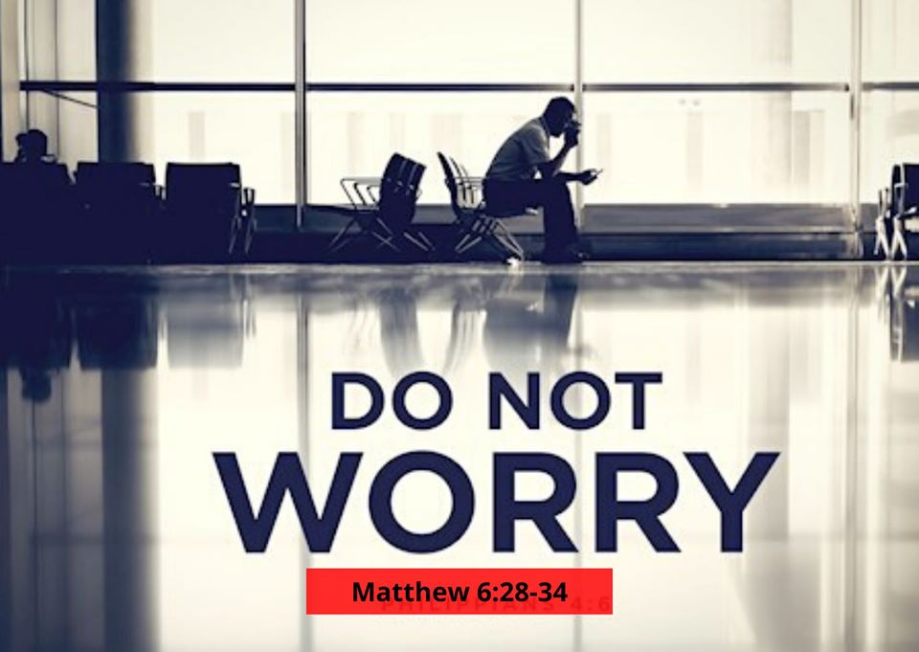
"Cast all your anxiety on Him because
He cares for you“ (1 Peter 5:7)

Slide 19
Our confidence in loving Him
"Seek first the kingdom of God and His righteousness and all these things will be added to you” (verse 33)

Slide 20
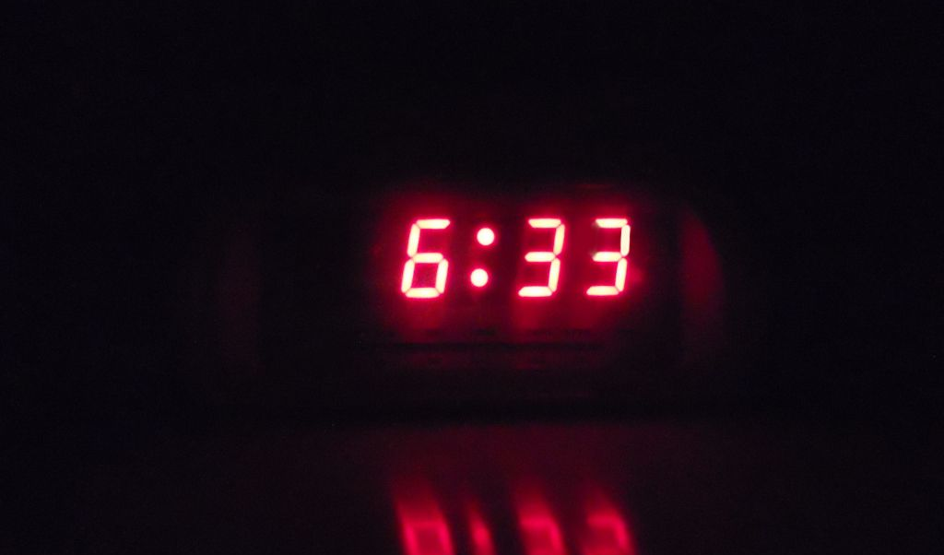
"Seek first the kingdom of God and His righteousness and all these things will be added to you”
Matthew 6:33

